Slide 1
Automated Multi Stock Trading
Amr Mohamed Abo Elyazid
Amr Mohamed Abd Albadea

Slide 2
Financial Markets
01
Brief History
02
Idea (Funds - Investments)
03
Mobilizing Funds
04
Price Determination
Liquidity
Easy Access
05
Developing new assets

Slide 3
Manual vs Electronic Trading

Slide 4
Participants
Institutions and big boys
Retail investors

Slide 5

Bullish vs bearish markets
Stochastic and complex
Portfolio Management (risk - diversification)

Slide 6
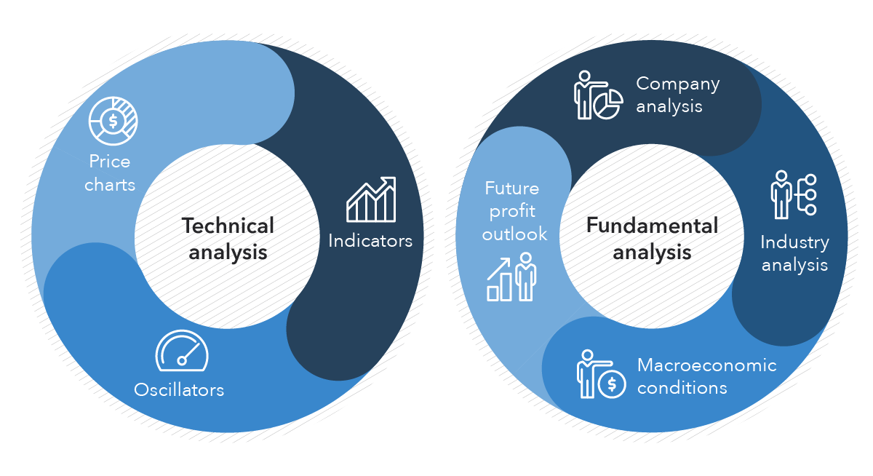
Developing Techniques

Slide 7
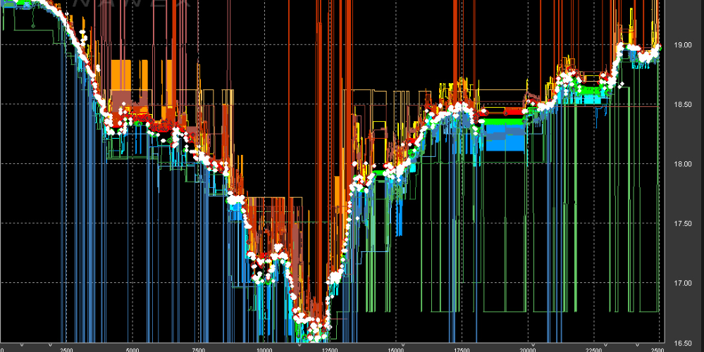
HFT and Quantitative “second wave”

Slide 8
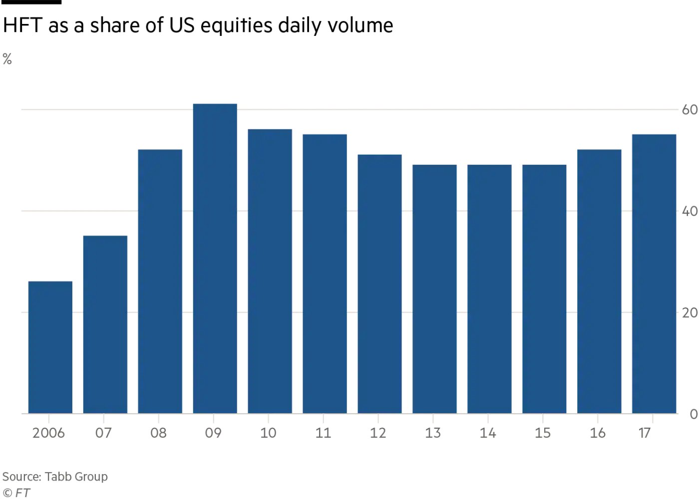
Second Wave

Slide 9
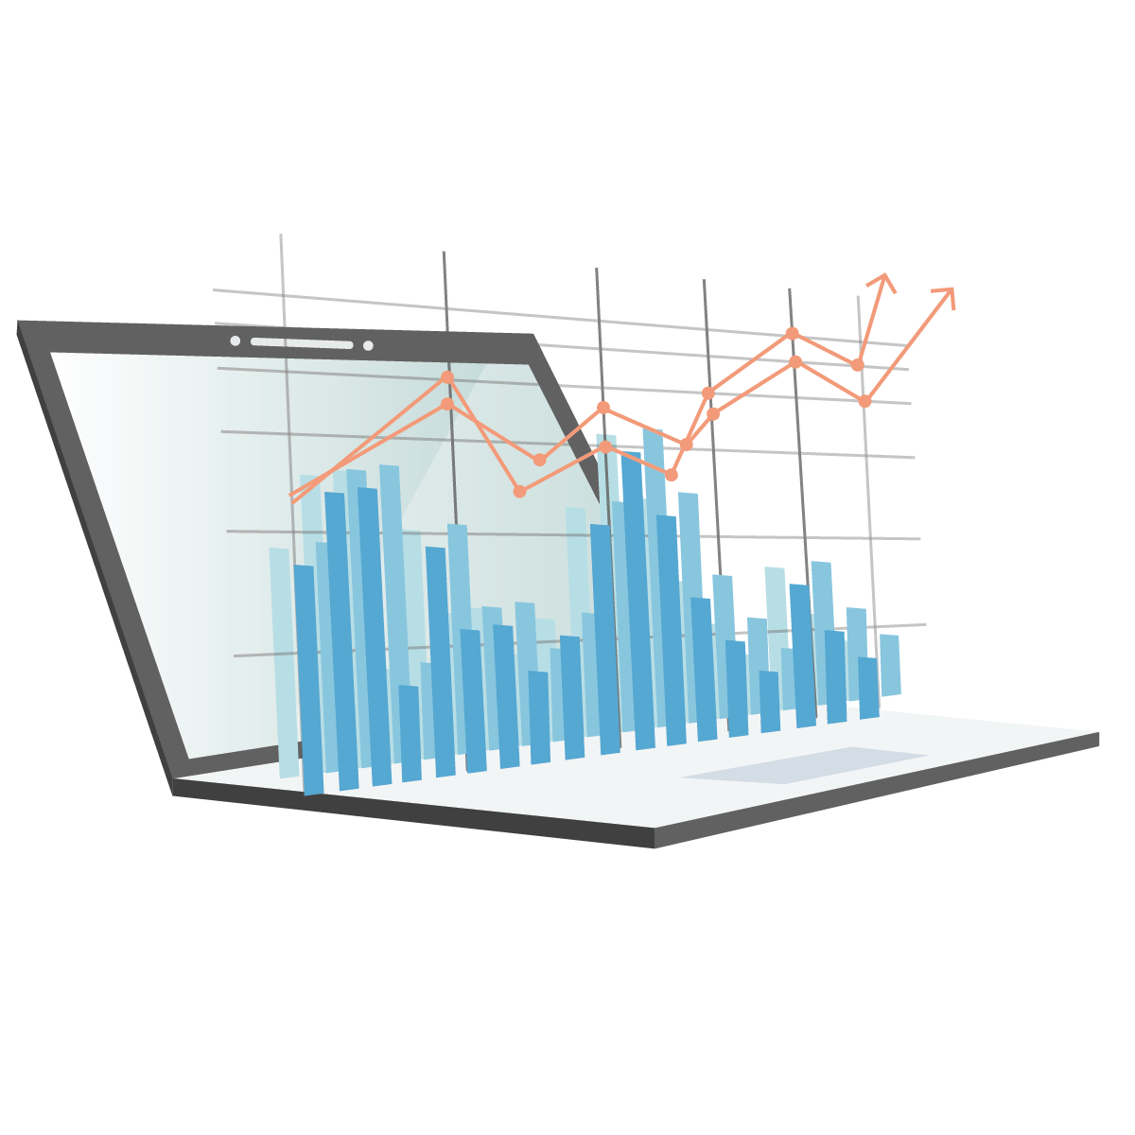
Problem definition
Multi-stock Trading

Slide 10
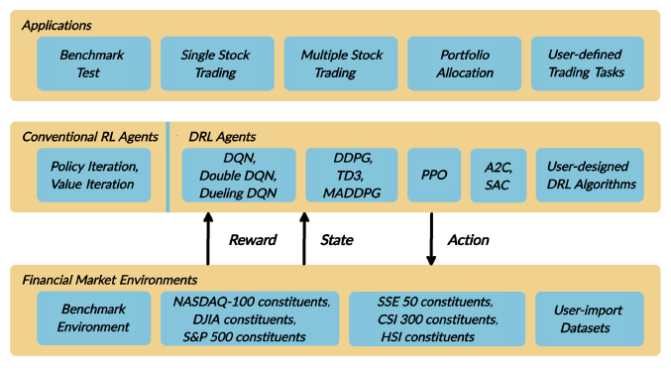
FinRL

Slide 11
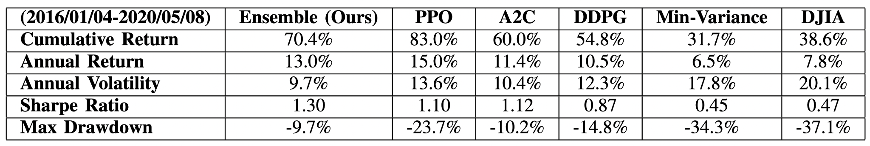
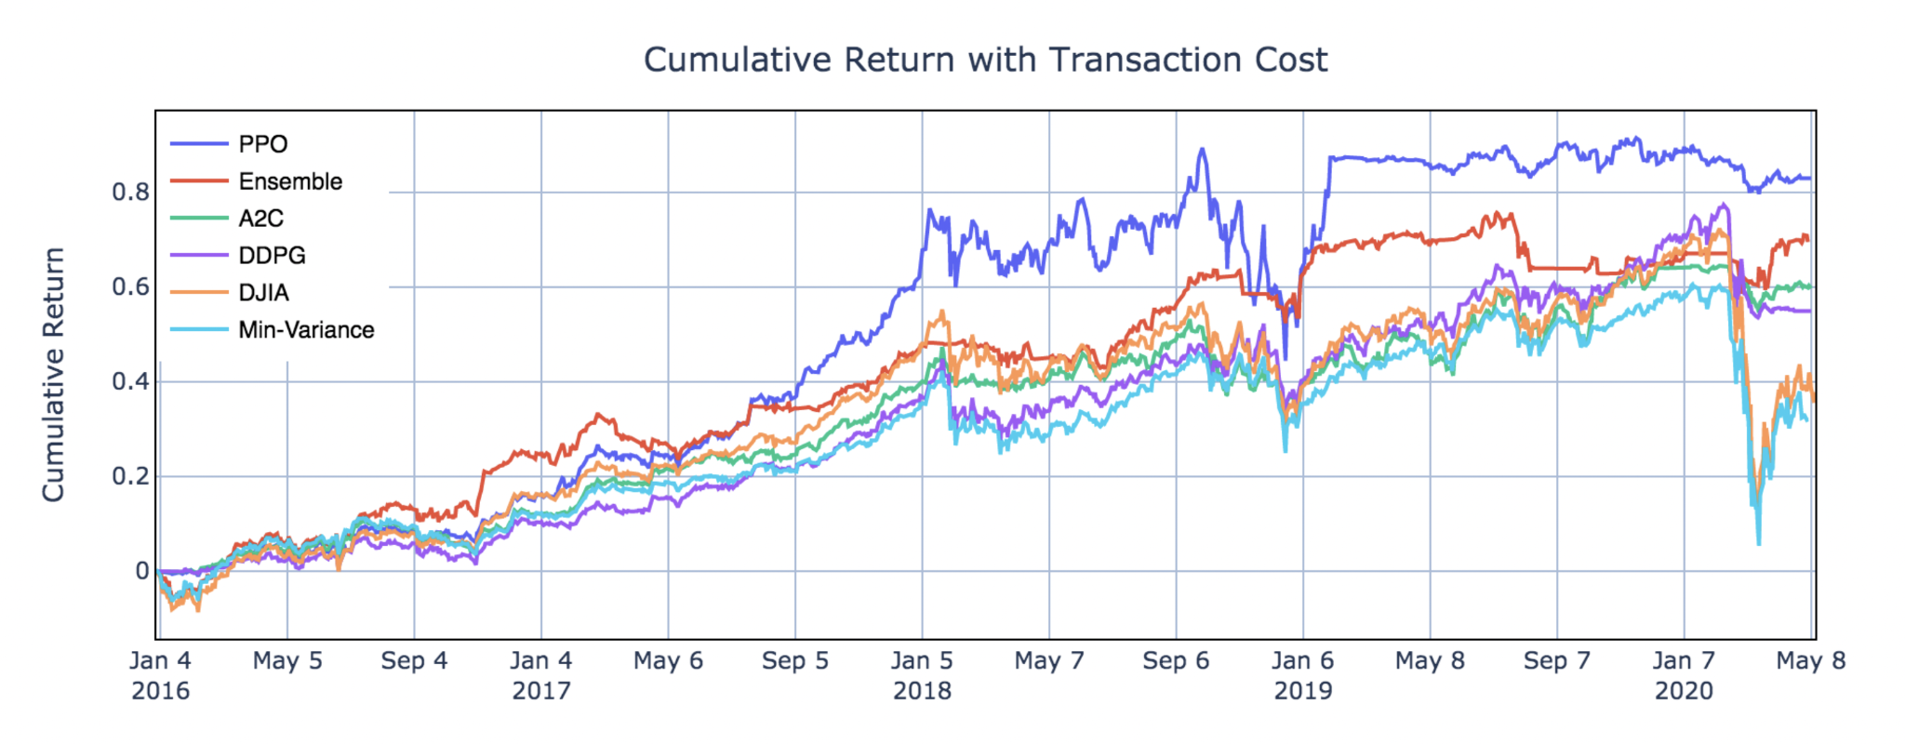
State of the art (FinRl ensemble stock trading)

Slide 12

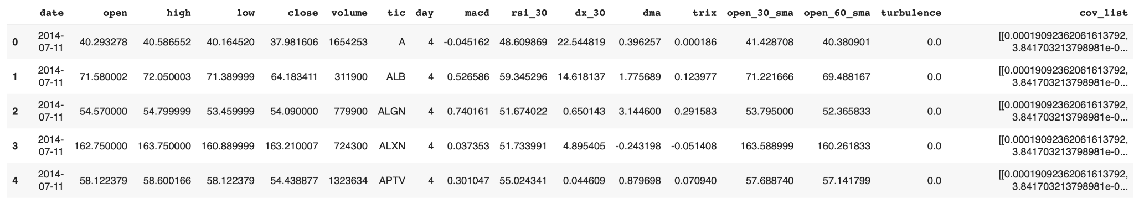
Design
01
Stock Screener
02
Gathering Data
03
Feature pipeline
Turbulence Index
Covariance Matrix
Technical Indicators (MACD, RSI, .. etc)

Slide 13

Reinforcement learning

Slide 14
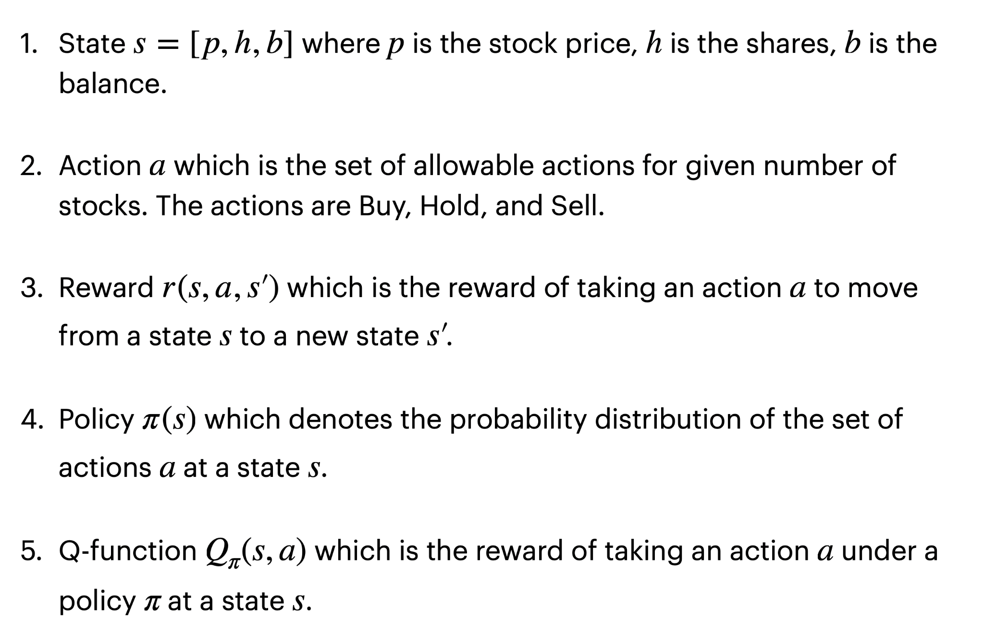
Markov Decision Process (MDP)

Slide 15
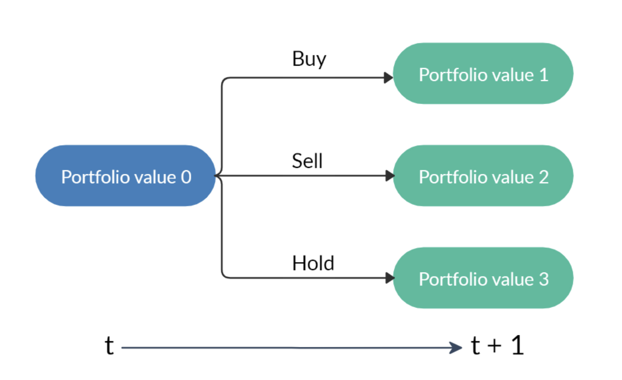
Action Scheme

Slide 16
Action Scheme Constraints
01
The market will not be affected by the agent
02
Non-negative balance
03
Transaction cost
04
Turbulence

Slide 17
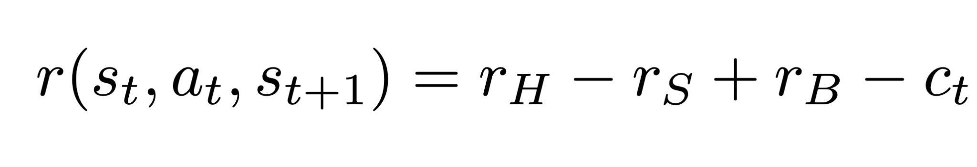

Reward Scheme
Portfolio value
Positive change
Buy & Hold
Negative change
Sell

Slide 18
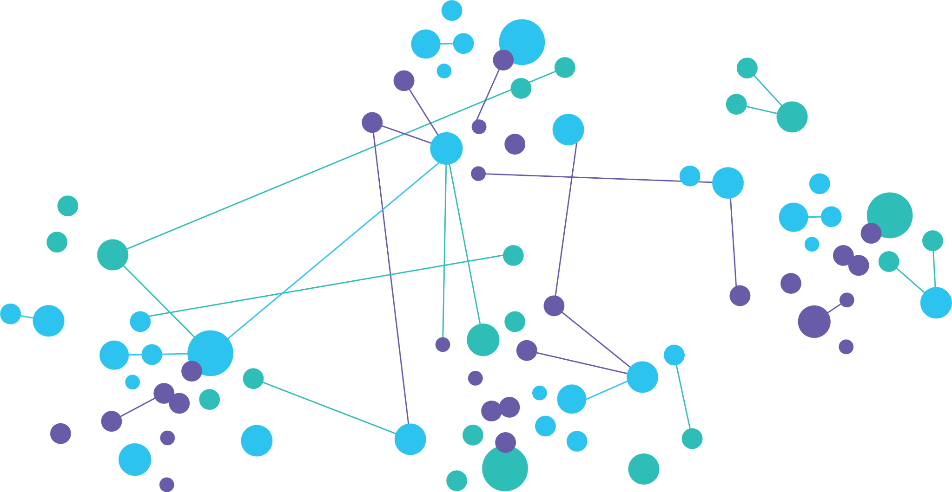
A2C Model (Advantage actor-critic)

Slide 19
Design Considerations
01
Dataset size
02
Hmax size
03
Number of steps

Slide 20
Results
Model | A2C | PPO | TD3 | SAC
Annual return | 1.058821 | 1.074517 | 1.014310 | 1.057710
Cumulative returns | 1.382808 | 1.404666 | 1.321004 | 1.381261
Annual Volatility | 0.245292 | 0.241528 | 0.234066 | 0.251107
Sharpe ratio | 3.070505 | 3.146100 | 3.112963 | 3.003008
Stability | 0.977314 | 0.978894 | 0.980532 | 0.973708
Max Drawdown | -0.136333 | -0.130428 | -0.128370 | -0.144274

Slide 21
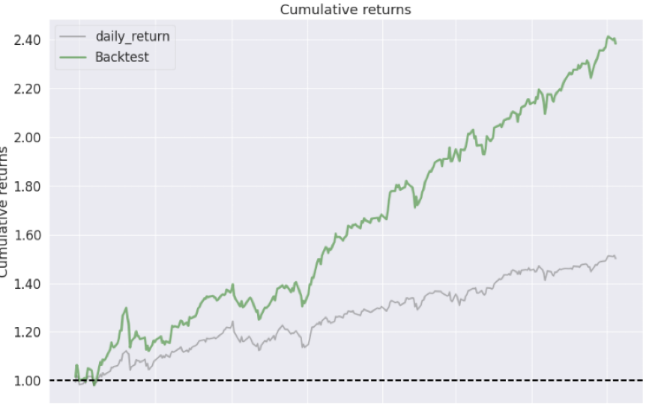
Results

Slide 22
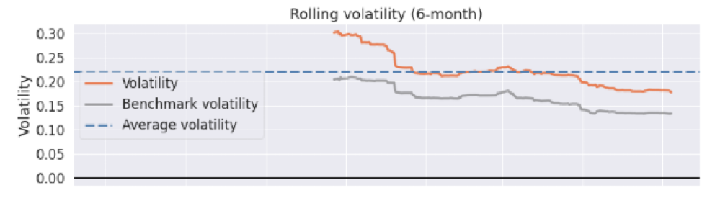
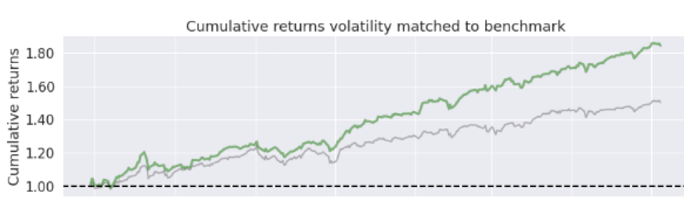
Results

Slide 23
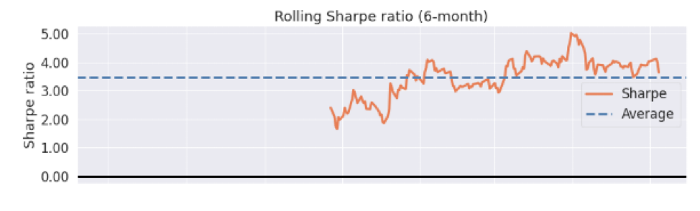
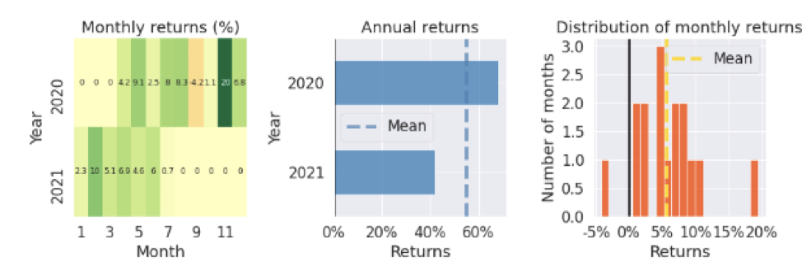
Results

Slide 24
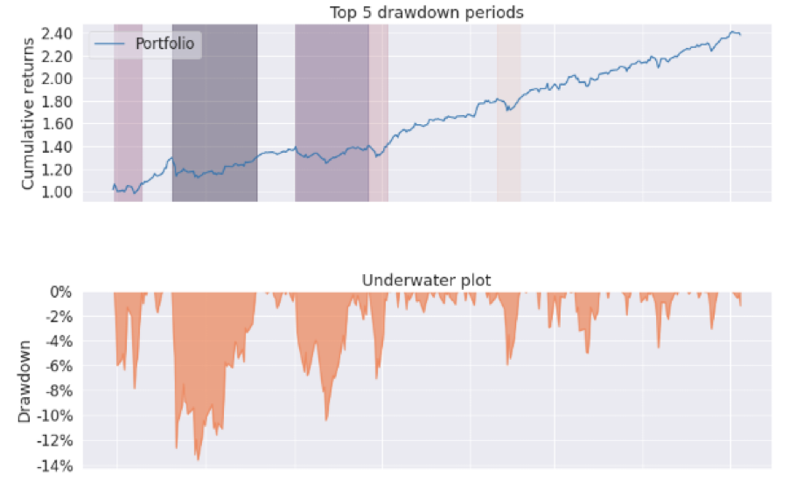
Results

Slide 25
Future improvements
01
Model Market reaction
02
More data
03
Production
04
Spoofing
05
Capital scaling

Slide 26
THANK YOU

